Slide 1
Budget Sales Analytics
Ansh Gupta

Slide 2
PROBLEM STATEMENT
Our "Domain Sale" process is structured to help potential buyers purchase the domain they want immediately without the hassle of contacting the seller directly. ... A seller lists a domain for sale at a specific price in our Marketplace. An interested buyer sees this domain for sale and decides to buy it.
Extract various information such as Sales, budget, and variance. You can even compare sales and budgets with various attributes. Extract necessary information about Products and
Customers. Make the necessary dashboard with the best you can extract from the data.

Slide 3
OBJECTIVE
Use various visualization and features and make the best dashboard. Find key metrics and factors and show the meaningful relationships between attributes. Do your own research and come up with your findings.

Slide 4





PROCESS
Step 1
Step 2
Step 3
Step 4
Step 5
Data Collection
Data Pre-Processing
Exploratory Data Analysis (EDA)
Finding Insights
Tableau Dashboard

Slide 5
DATASET INFORMATION
This dataset includes Keys, gender, categories, country-wise and year-wise data of “Domain Retail & Sales” for comprehensive investment analysis from 2014 to 2016.

Slide 6
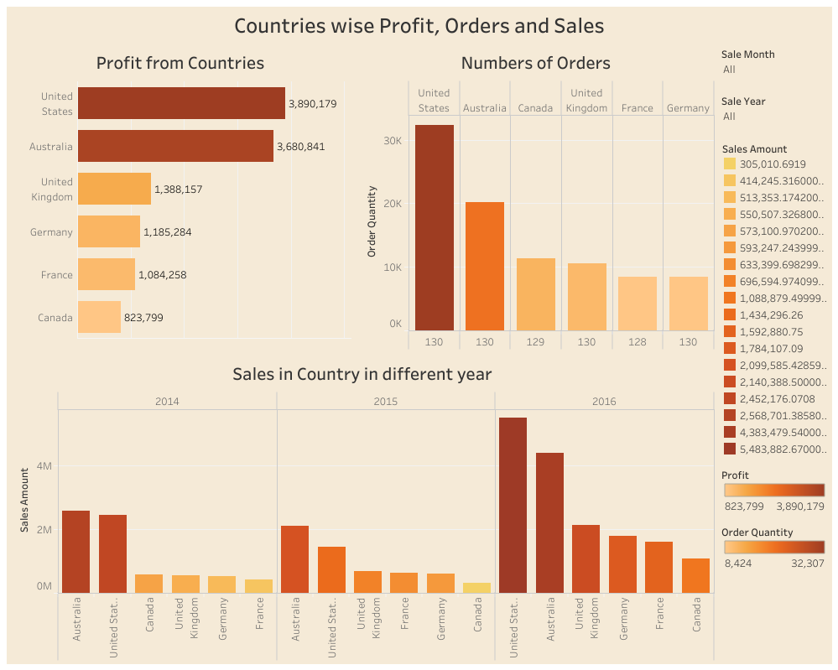

Slide 7
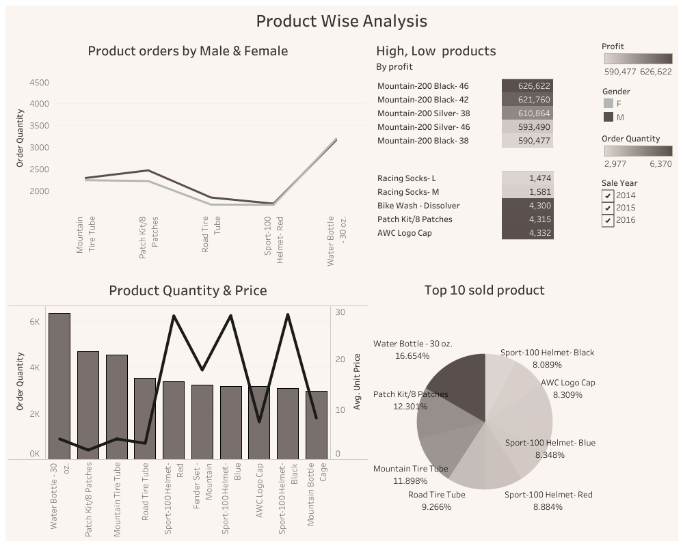

Slide 8
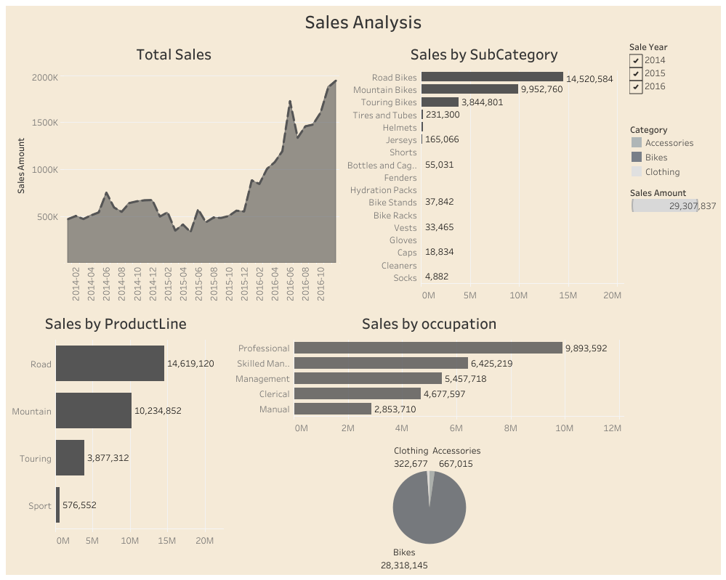

Slide 9
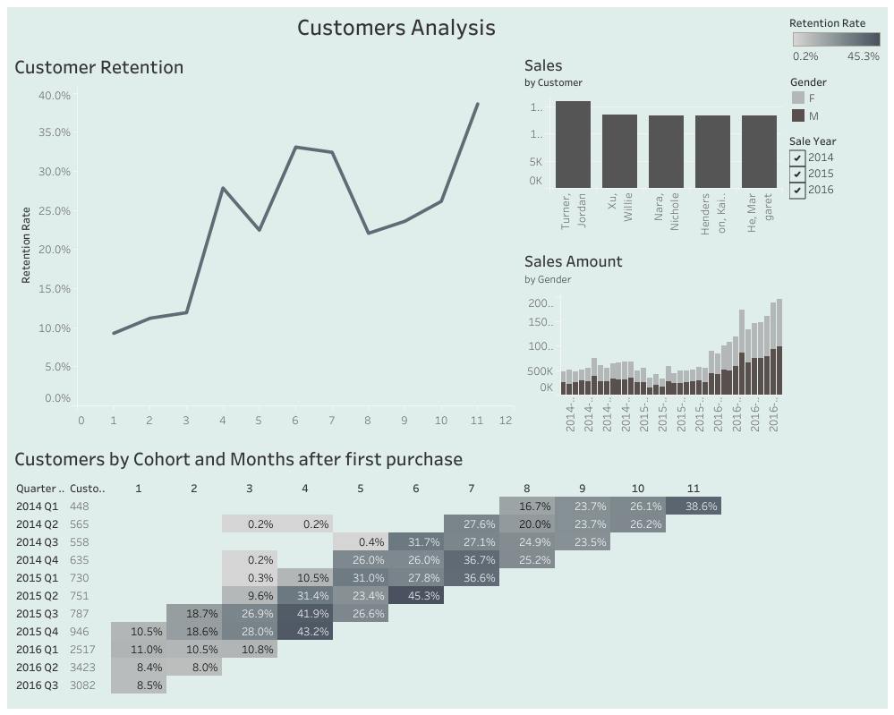

Slide 10
AREAS OF FOCUS
Maximum quantity ordered for a product is below 5
The year 2016 saw an exponential surge in sales
According to the above distribution plot we can conclude that maximum of the product unit price is below $1000
Since August of 2015, we have noticed some customers returning, though not in large numbers. 2016 brought about a slight improvement in retention
There is a high negative correlation between Price and number of Quantity ordered. We can conclude that low price product has high demand
High sales orders are seen on Wednesday and Saturday; therefore, we can promote our product during these workweek
High quantity of products is ordered from Australia and United States
Customers with a high school diploma and modest annual income buy more products than people with bachelor's degrees

Slide 11
SUMMARY
The clientele predominantly comprises individuals aged 40-59, with 2016 marking a significant surge in sales. Australia and the United States are key sources of high product orders, particularly in the Bike category, which contributes majorly to profits. Orders typically experience a 7-day gap between factory readiness and shipment. Peak profit months are June, November, and December, while Wednesdays and Saturdays see heightened sales. Negative correlation exists between price and quantity ordered. Men without permanent addresses spend less compared to women, with age groups 40-49 and 50-59 showing heightened demand. Higher salary correlates with increased revenue, and individuals with high school diplomas and modest income purchase more. Approximately 15% of clients are high value, with the majority categorized as low value or lost. Client retention was subpar in 2014 but showed slight improvement in 2016.

Slide 12
THANK YOU
Ansh Gupta

